Slide 1
Java Concurrency Overview

Slide 2
Pregled kursa
Osnove threadova u Java-i
Threading best practice i concurrency package
Fork Join frejmvork
Paralelni streamovi i lambde

Slide 3
Osnove threadova u Java-i
Threadovi / niti omogućavaju pisanje programa sa paralelnim tokovima izvršavanja
Kreiranje threadova
Klasa Thread
Nasledjivanje klase Thread I override metode run()
Interfejs Runnable
Implementacija interfejsa se prosledjuje kao parametar konstruktoru Thread-a
Runnable je funkcionalni interfejs od Java 8

Slide 4
Glavni izazovi u radu sa thredovima
Zajednicki podaci (shared data)
Cekanje – minimizovati (po mogucstvu eliminisati) portrebu za sinhronizacijom I cekanjem
Threadovi rade razlicitim brzinama, razlicite kolicine posla I dodeljivanje procesora je nepredvidivo
Kolicina posla po jednom threadu– treba da bude dovoljno velika da bi opravdala paralelizaciju inace ce raditi sporije nego u jednom thread-u

Slide 5
Primeri
BasicCounterThreads
BasicRunnableThreads
TwoCounters
TwoSharedCounterThreads

Slide 6
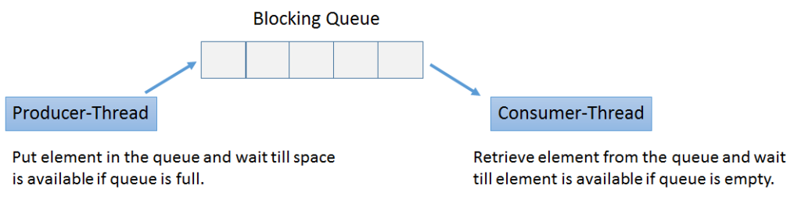
Cosumer Producer
Consumer/Producer
Wait / notify

Slide 7
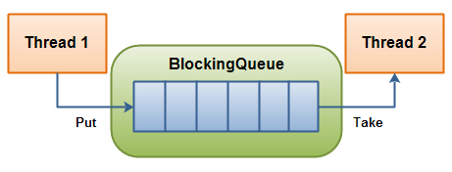
Blocking Queue

Slide 8
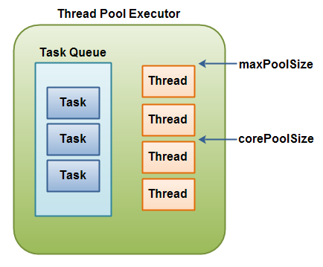
Thread Pool

Slide 9
Zasto java.util.concurrency
Josh Bloch, Effective Java 2nd Edition, Item 69: Prefer concurrency utilities to wait and notify
Given the difficulty of using wait and notify correctly, you should use the higher-level concurrency utilities instead [...] using wait and notify directly is like programming in "concurrency assembly language", as compared to the higher-level language provided by java.util.concurrent. There is seldom, if ever, reason to use wait and notify in new code.

Slide 10
java.util.concurrent
Zasto java.util.concurrent?
Thread Pools, Blocking Queue
ExecutorService interfejs
Klase Callable i Future
Kreiranje threadova pomocu factory klase Executors
Executors.newFixedThreadPool()
Executors.newCachedThreadPool()
creates new threads as needed, but will reuse previously constructed threads when they are available.

Slide 11
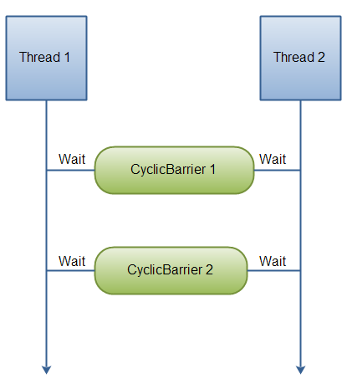
Cyclic Barrier
CyclicBarrier barrier = new CyclicBarrier(2);
barrier.await();

Slide 12
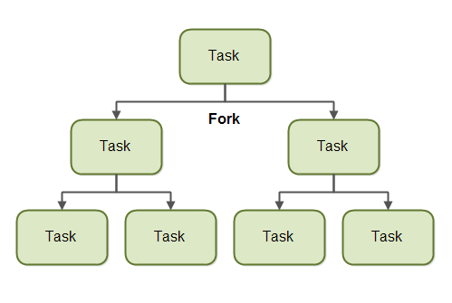
Fork Join Framwork
RecursiveAction
RecursiveTask
Common fork join pool
Work stealing
http://www.oracle.com/technetwork/articles/java/fork-join-422606.html

Slide 13
Java Concurrent Animated
https://sourceforge.net/projects/javaconcurrenta/

Slide 14
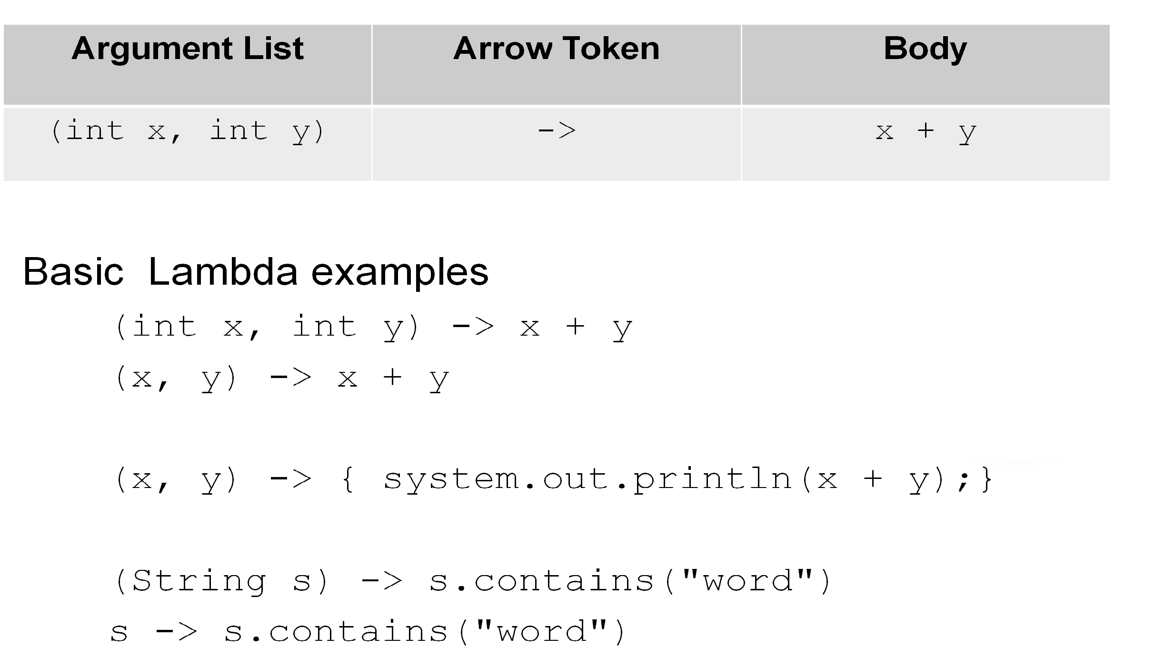
Lambda izrazi
Lambda izrazi su skracena sintaksa za interfejse sa samo jednom metodom. Pogledati java.util.function
Consumer
Predicate
Function
BiFunction
https://docs.oracle.com/javase/8/docs/api/java/util/function/package-summary.html

Slide 15
Stream-ovi
Stream je sekvence elemenata nad kojima se mogu
primeniti niz operacija (koje se najcesce zadaju pomocu lambda izraza)
Stream podrzava intermediate I terminalne operacije

Slide 16
Parallel Streams & Lambdas
Stream.stream() i Stream.parallelStream()
foreach() - primeni na svaki element strima
map() - transformisi elemente strima
filter() - filtriraj elemente strima
collect() - pretvori strim u kolekciju
Ispod haube paralelnog strima je Fork Join frejmvork
https://docs.oracle.com/javase/tutorial/collections/streams/parallelism.html
http://winterbe.com/posts/2014/07/31/java8-stream-tutorial-examples/

Slide 17
Literatura
Java Concurrency In Practice, Brian Goetz
https://www.amazon.com/Java-Concurrency-Practice-Brian-Goetz/dp/0321349601

